Slide 1
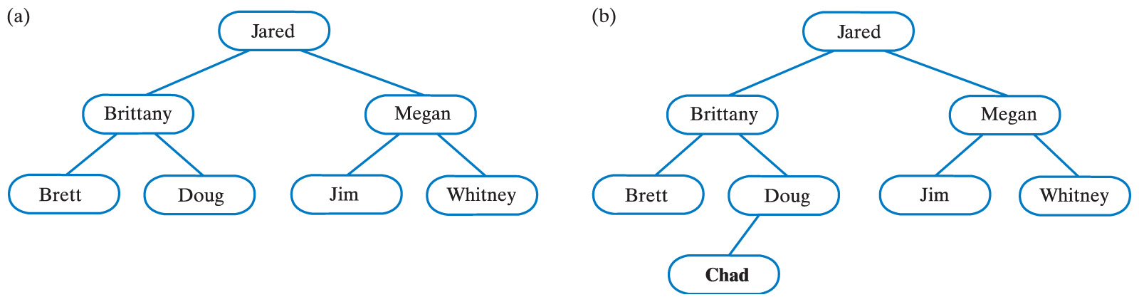
Adding an Entry
Fig. 27-4 (a) A binary search tree;
(b) the same tree after adding Chad.
Carrano, Data Structures and Abstractions with Java, Second Edition, (c) 2007 Pearson Education, Inc. All rights reserved. 0-13-237045-X

Slide 2
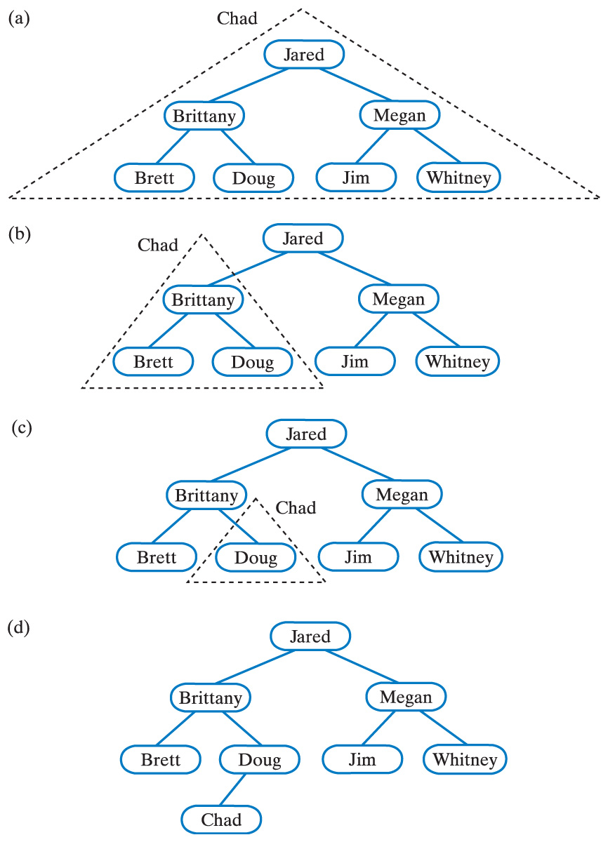
Adding an Entry Recursively
Fig. 27-5 Recursively adding Chad to smaller subtrees of a binary search tree … continued →
Carrano, Data Structures and Abstractions with Java, Second Edition, (c) 2007 Pearson Education, Inc. All rights reserved. 0-13-237045-X

Slide 3
Adding an Entry Recursively
Fig. 27-5 (ctd.) Recursively adding Chad to smaller subtrees of a binary search tree.
Click to view recursive method addEntry()
Click to view iterative method addEntry() (optional)
Carrano, Data Structures and Abstractions with Java, Second Edition, (c) 2007 Pearson Education, Inc. All rights reserved. 0-13-237045-X

Slide 4
Removing an Entry
The remove() method must receive an entry to be matched in the tree
  If found, it is removed
  Otherwise the method returns null
Three cases
  The node has no children, it is a leaf (simplest case)
  The node has one child
  The node has two children
Carrano, Data Structures and Abstractions with Java, Second Edition, (c) 2007 Pearson Education, Inc. All rights reserved. 0-13-237045-X

Slide 5
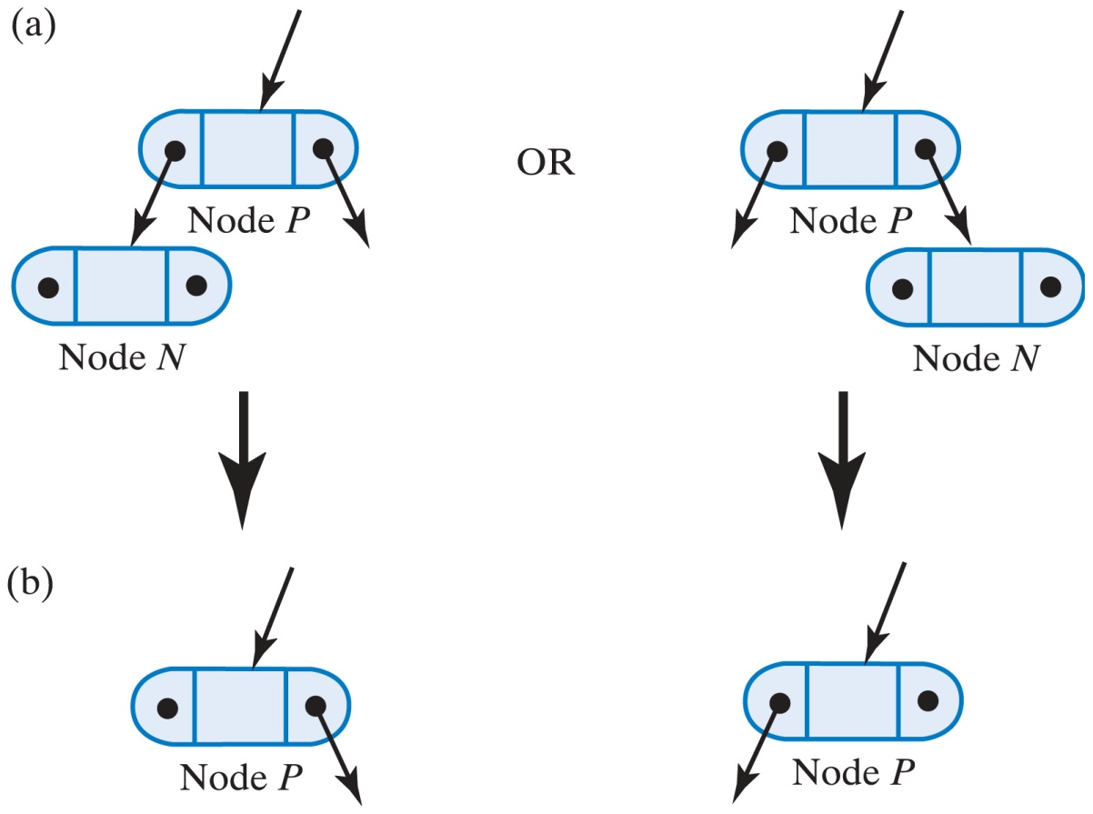
Removing an Entry, Node a Leaf
Fig. 27-6 (a) Two possible configurations of leaf node N; (b) the resulting two possible configurations after removing node N.
Carrano, Data Structures and Abstractions with Java, Second Edition, (c) 2007 Pearson Education, Inc. All rights reserved. 0-13-237045-X

Slide 6
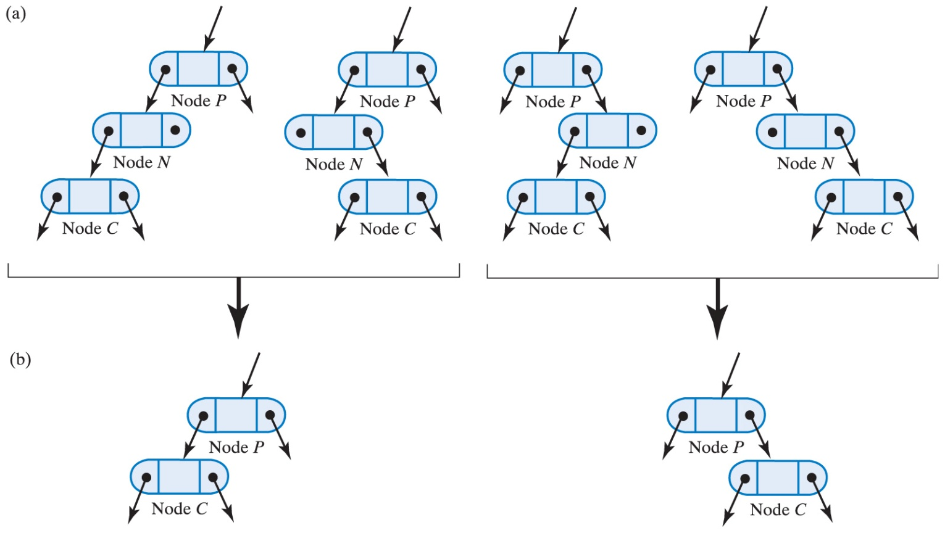
Removing Entry, Node Has One Child
Fig. 27-6 (a) Two possible configurations of leaf node N;
(b) the resulting two possible configurations after removing node N.
Carrano, Data Structures and Abstractions with Java, Second Edition, (c) 2007 Pearson Education, Inc. All rights reserved. 0-13-237045-X

Slide 7
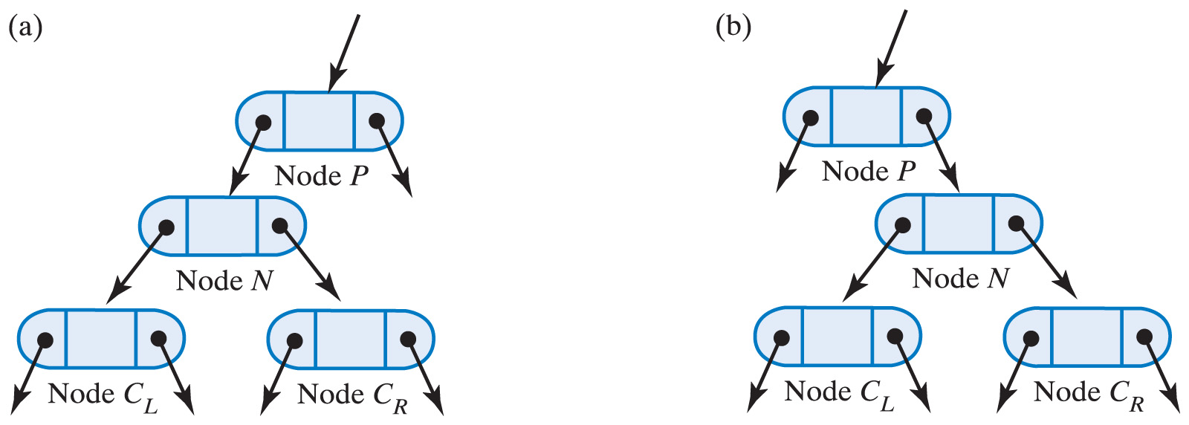
Removing Entry, Node Has Two Children
Fig. 27-8 Two possible configurations of node N that has two children.
Carrano, Data Structures and Abstractions with Java, Second Edition, (c) 2007 Pearson Education, Inc. All rights reserved. 0-13-237045-X

Slide 8
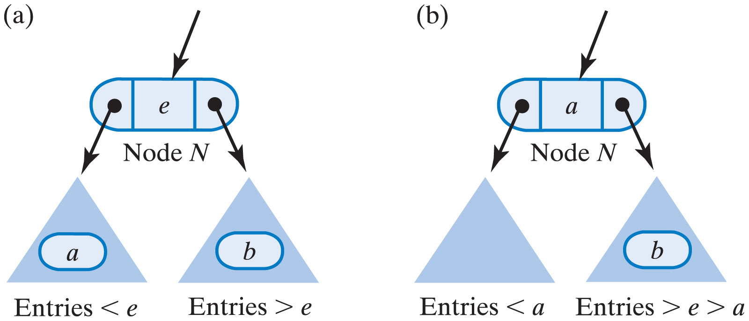
Removing Entry, Node Has Two Children
Fig. 27-9 Node N and its subtrees; (a) entry a is immediately before e, b is immediately after e; (b) after deleting the node that contained a and replacing e with a.
Carrano, Data Structures and Abstractions with Java, Second Edition, (c) 2007 Pearson Education, Inc. All rights reserved. 0-13-237045-X

Slide 9
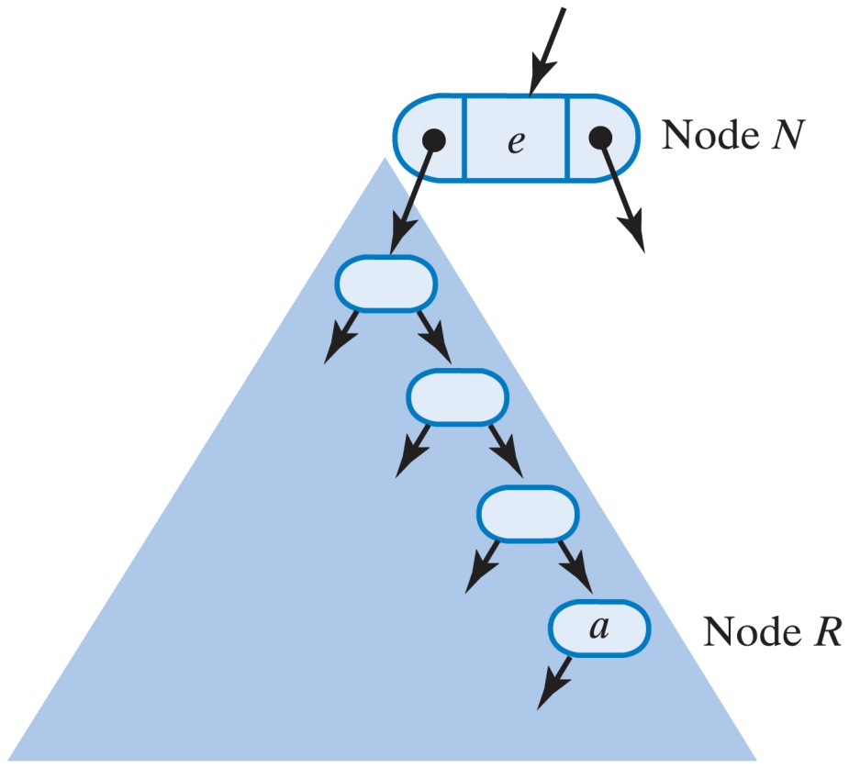
Removing Entry, Node Has Two Children
Fig. 27-10 The largest entry a in node N's left subtree occurs in the subtree's rightmost node R.
Carrano, Data Structures and Abstractions with Java, Second Edition, (c) 2007 Pearson Education, Inc. All rights reserved. 0-13-237045-X

Slide 10
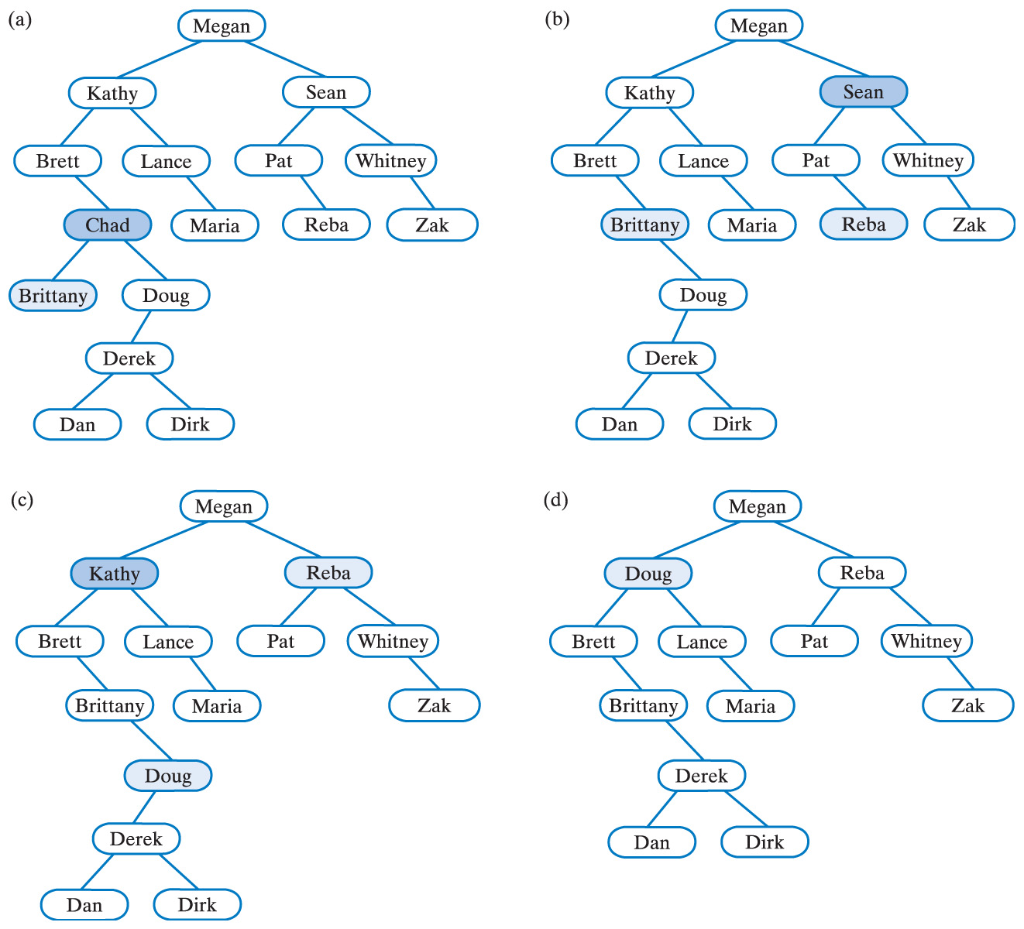
Removing Entry, Node Has Two Children
Fig. 27-11 (a) A binary search tree;
(b) after removing Chad;
Carrano, Data Structures and Abstractions with Java, Second Edition, (c) 2007 Pearson Education, Inc. All rights reserved. 0-13-237045-X

Slide 11
Removing Entry, Node Has Two Children
Fig. 27-11 (c) after removing Sean;
(d) after removing Kathy.
Carrano, Data Structures and Abstractions with Java, Second Edition, (c) 2007 Pearson Education, Inc. All rights reserved. 0-13-237045-X

Slide 12
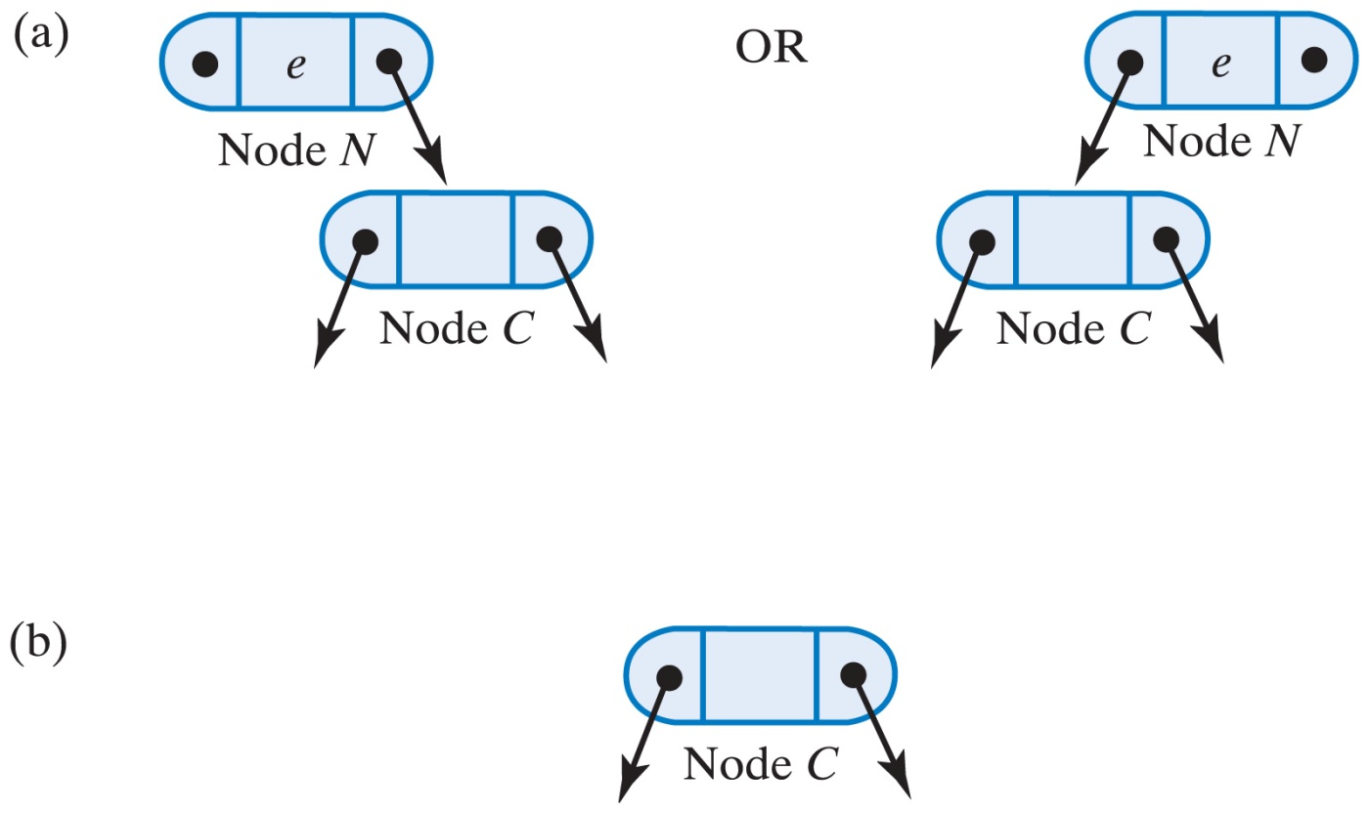
Removing an Entry in the Root
Fig. 27-12 (a) Two possible configurations of a root that has one child; (b) after removing the root.
Carrano, Data Structures and Abstractions with Java, Second Edition, (c) 2007 Pearson Education, Inc. All rights reserved. 0-13-237045-X

